Slide 1
Online Movie Ticket Booking
Showbuzz.com

Slide 2
INTRODUCTION
Main purpose of developing the Online Movie Ticket Booking System is to maximize the easiness of the customers to book tickets which would otherwise have to be booked by standing in long queues at the theatres. This system will help them and save their time .

Slide 3
Technologies used
We used Java Spring-Boot as backend and React JS as Frontend in our Project.
Spring-Boot :–
The main goal of the Spring Boot framework is to reduce overall development time and increase efficiency. React has become the first choice for frontend because it gives developers the ability to work with a virtual browser (more friendly than the real browser). Also, a JavaScript developer can become a productive developer in a few hours because there is a small API to learn, a few functions, and how to use them…
React :–
React allows developers to create large web applications that can change data, without reloading the page. The main purpose of React is to be fast, scalable, and simple.

Slide 4
Use Classes
User
Manager
Admin
In this module, user will register, sign in or edit profile ,book movie and can make payments.
In this module, manager will Manage shows , theatres and manage seats
In this module, admin will upload movies , seats , cities and delete movies, seats, cities or edit movies , seats and cities.

Slide 5
Product functions
1.The system provides efficient way to use the services by user, admin and manager.
2.The system provides easy interface that users can easily
3.Personalized Dashboard for Admin and Manager.

Slide 6
User Module
After successful registration ,the user can
Can select city as his/her choice
Then Can select movie as per choice on the different dates from the different theatres as per choice
Then can select seats and make payment
Can edit his/her profile .

Slide 7
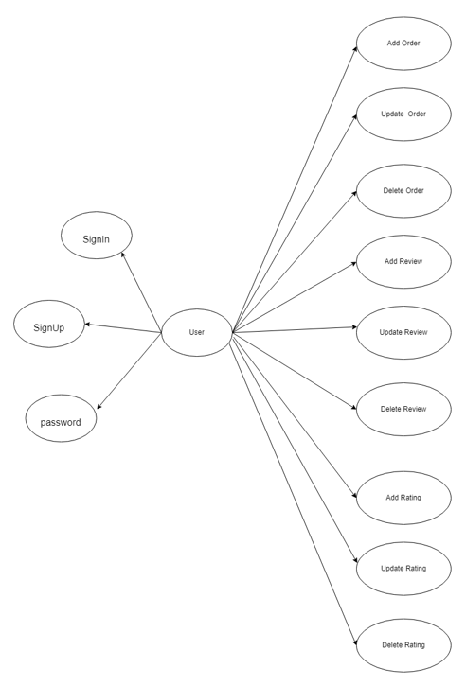
Use case diagram for User :-

Slide 8
Manager Module
After successful login ,the manager can
Can manage the shows , can edit , add and delete shows from the theatres
Can manage the screens , can edit , add and delete screens from theatres

Slide 9
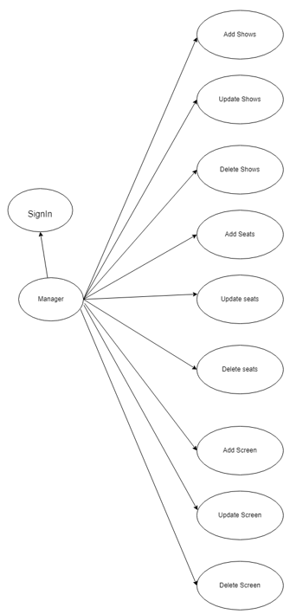
Use case diagram for Manager :-

Slide 10
Admin Module
After successful login ,the admin can
Can add, delete and edit city
Can add , delete and edit theatres
Can add ,delete and edit movies

Slide 11
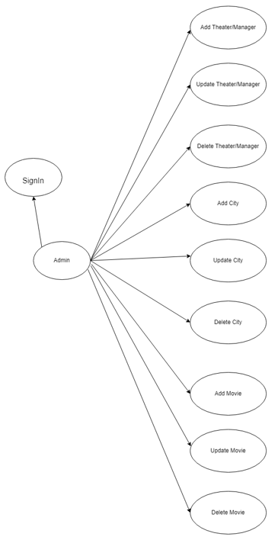
Use case diagram for Admin :-

Slide 12
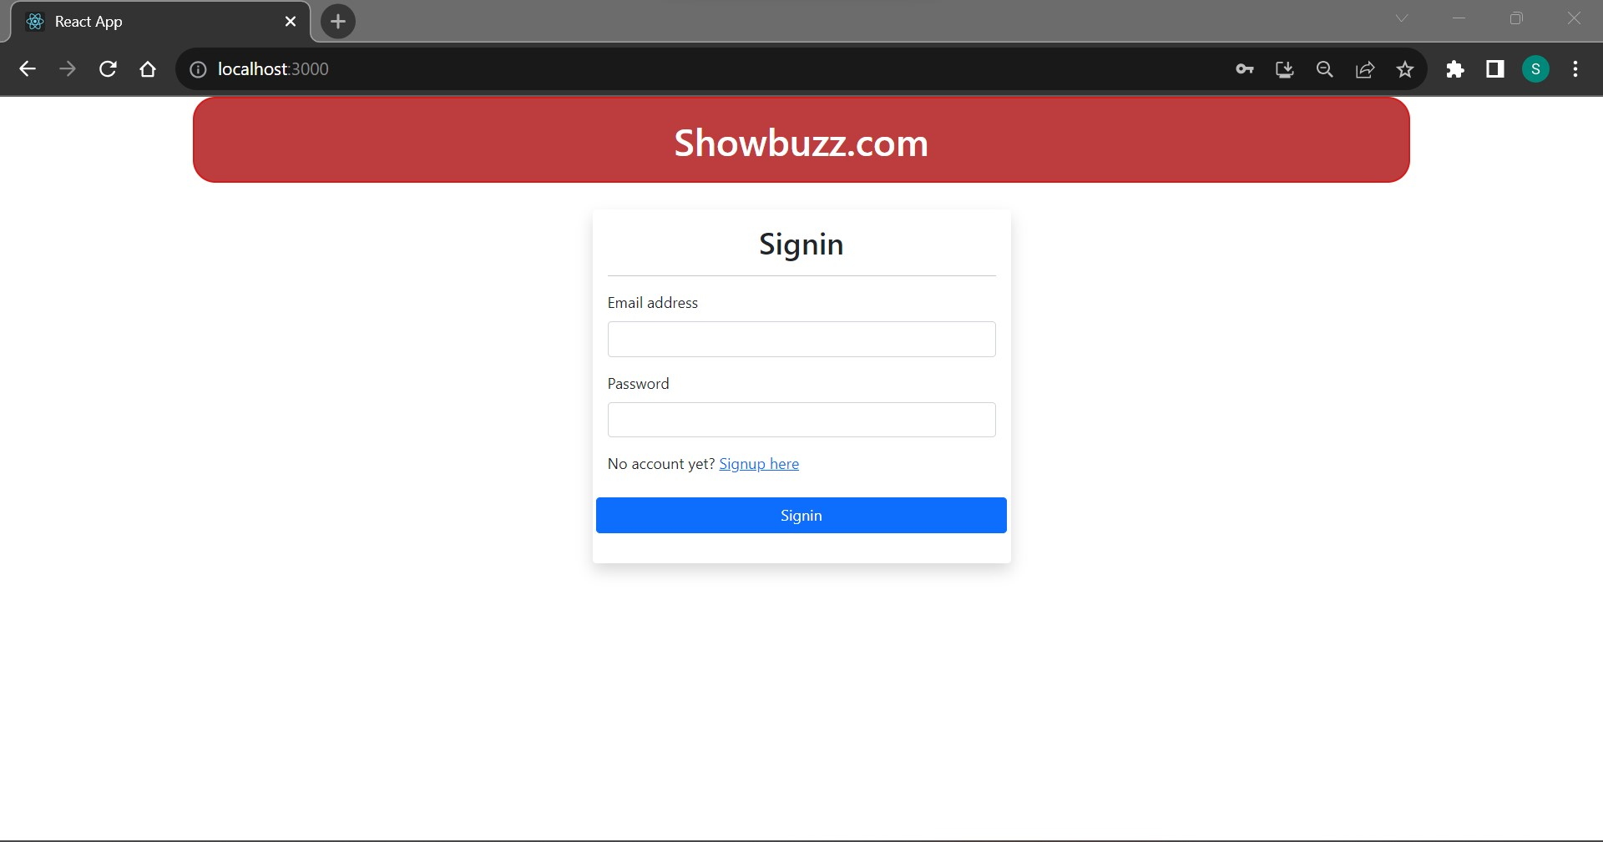

Slide 13
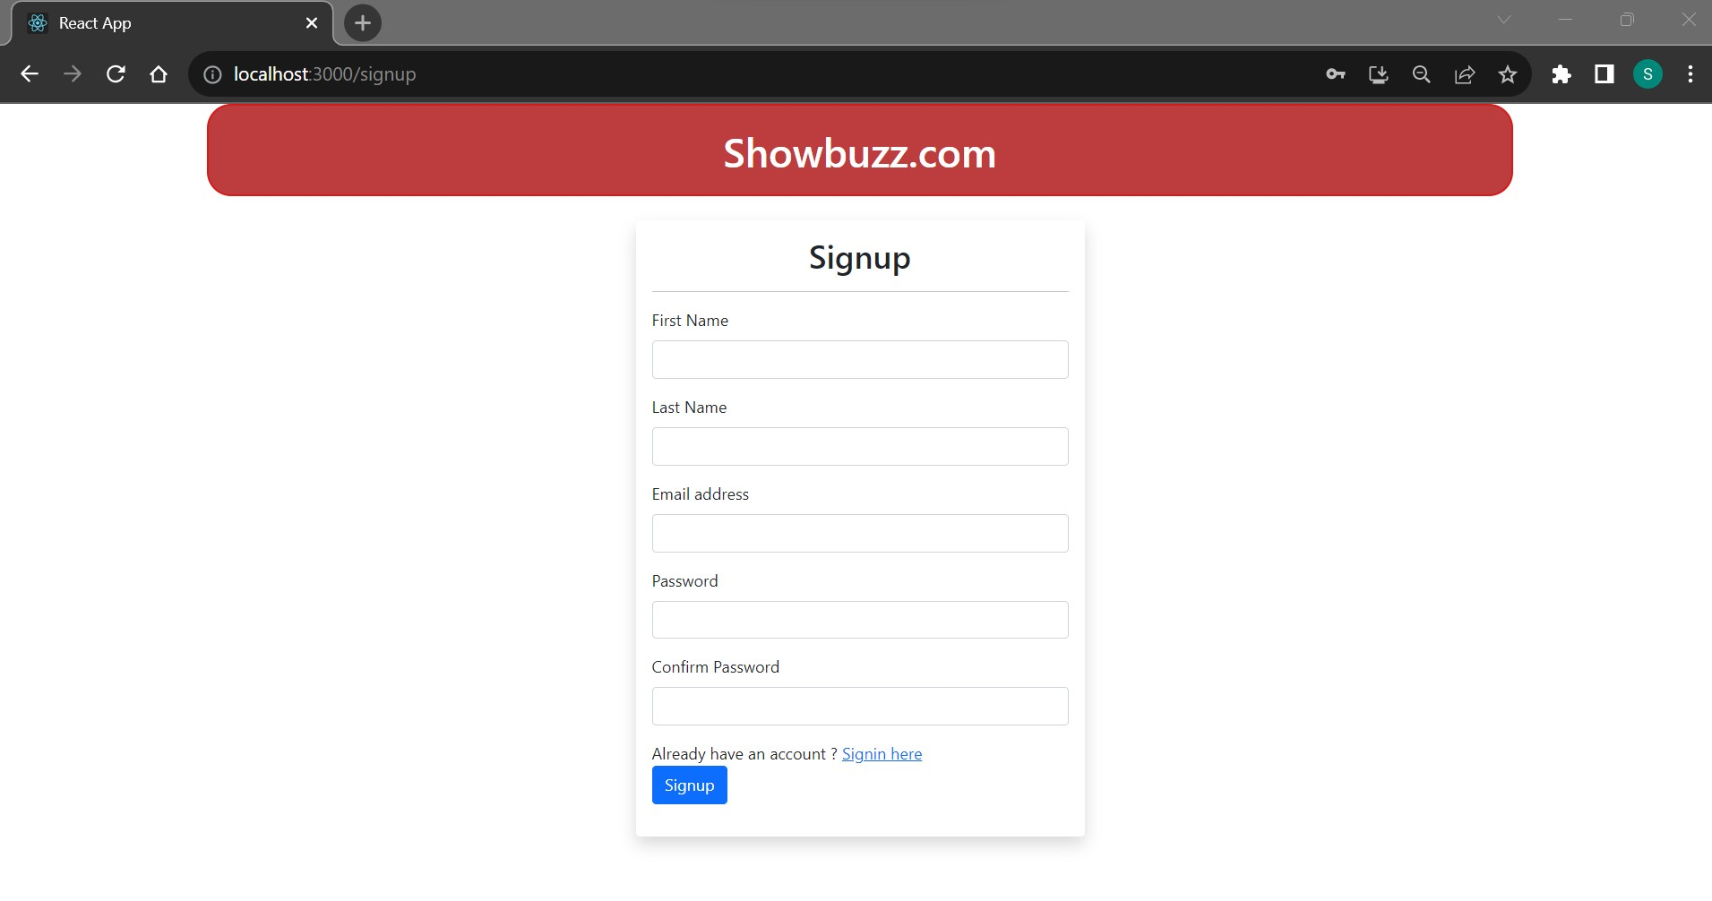

Slide 14
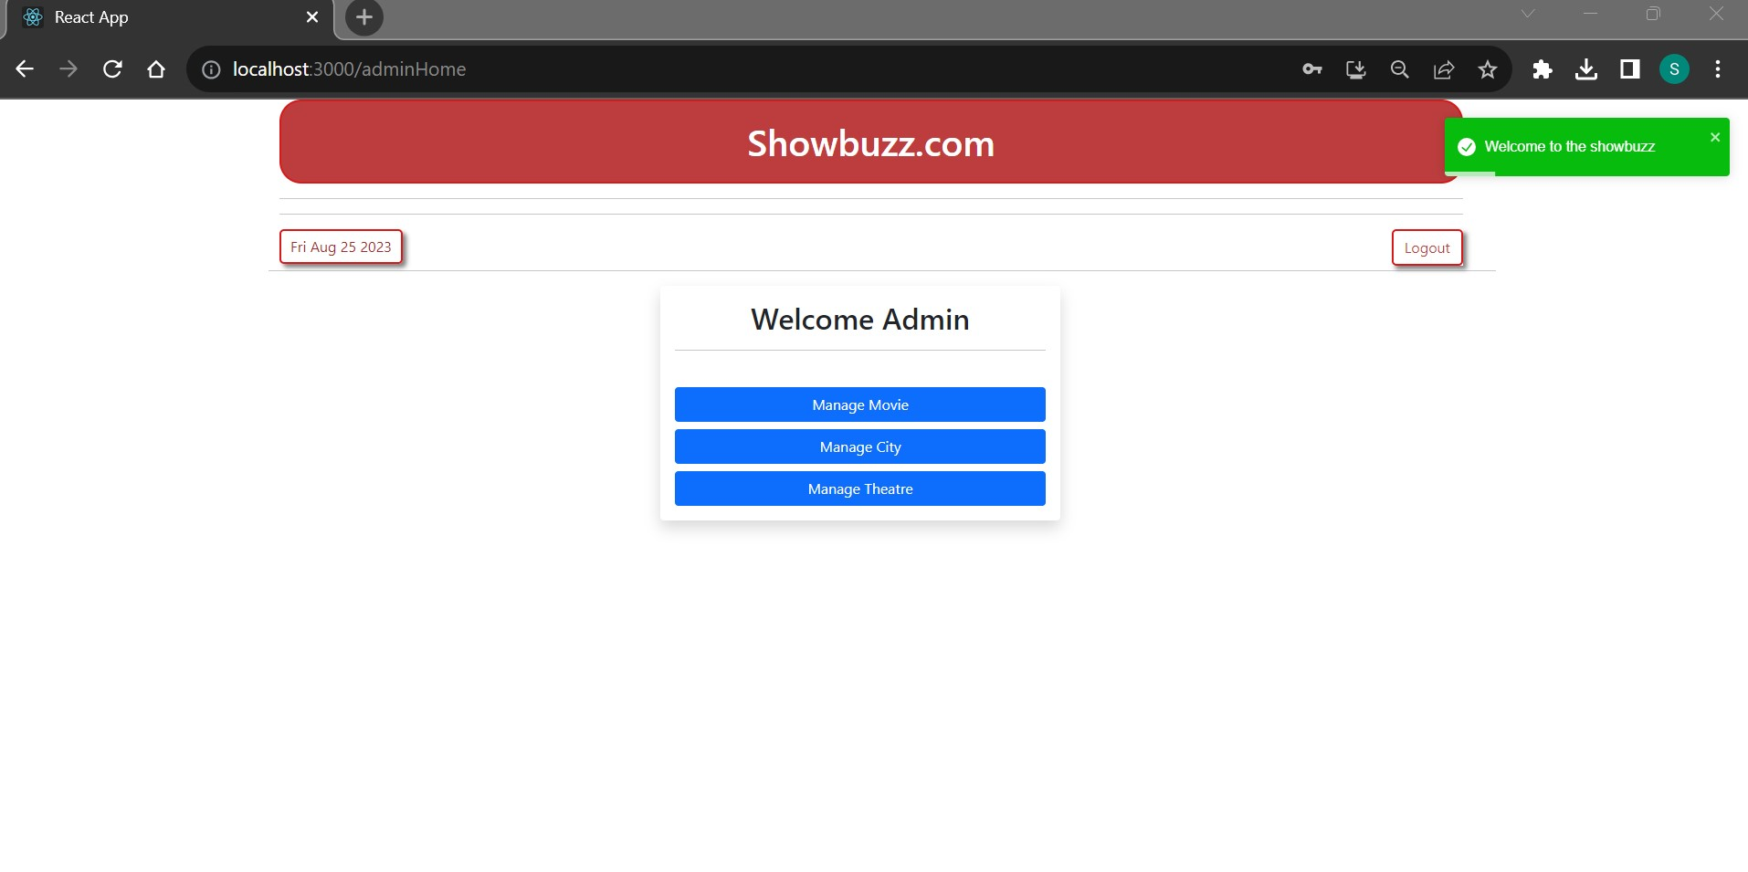

Slide 15
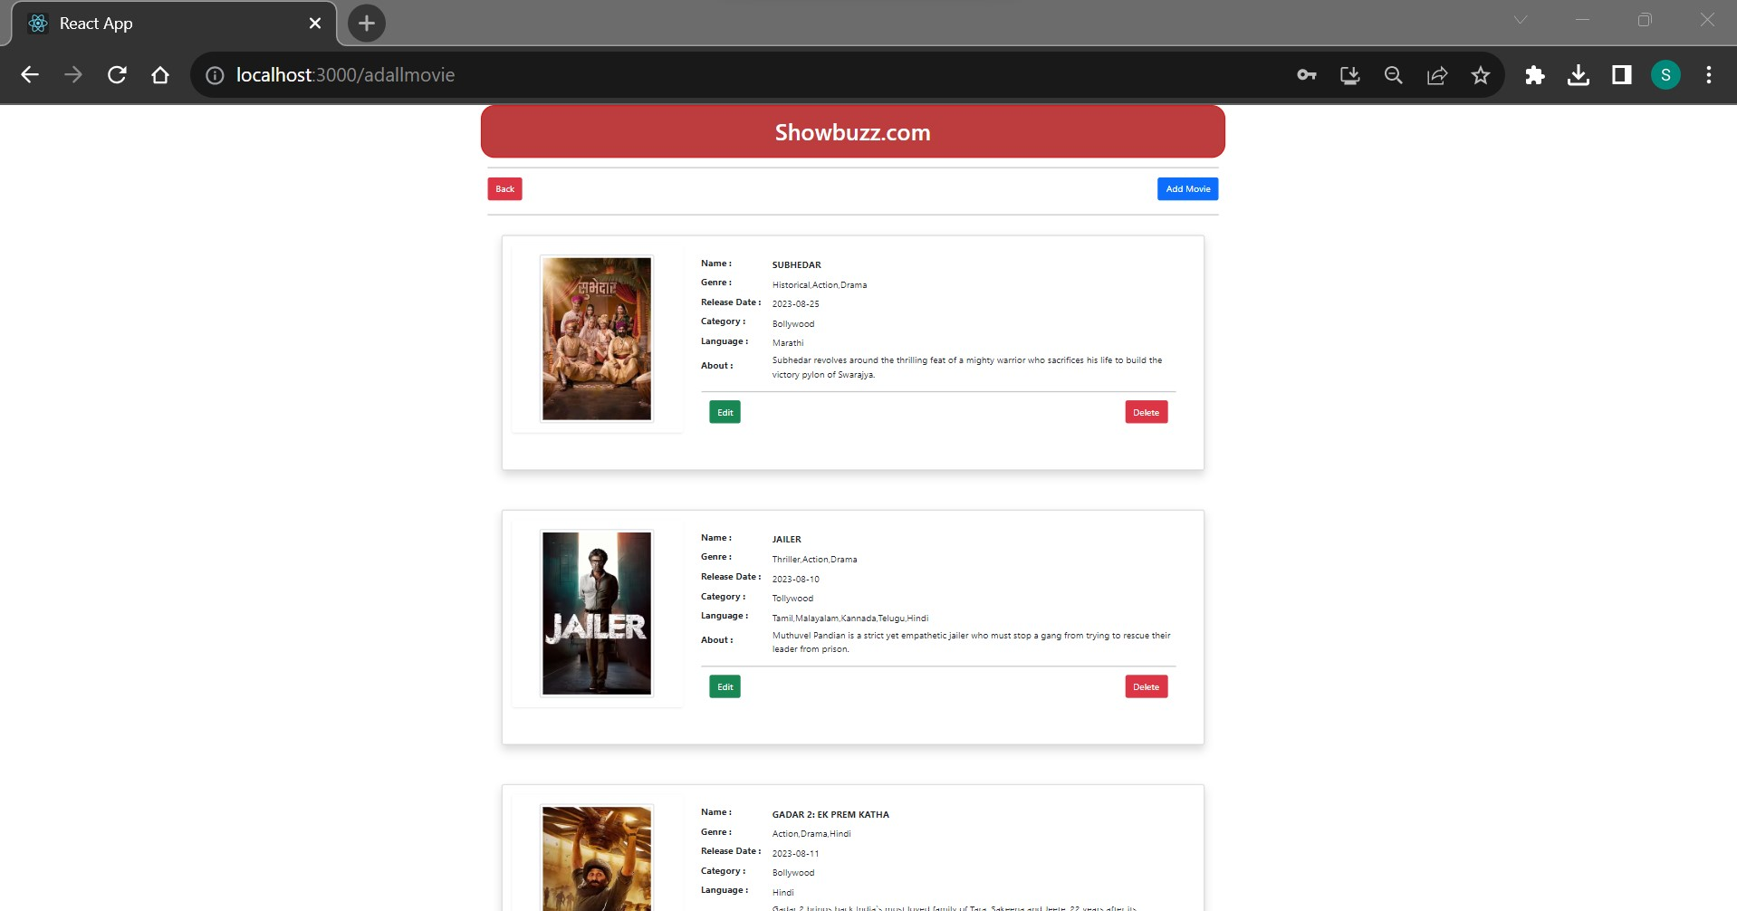

Slide 16
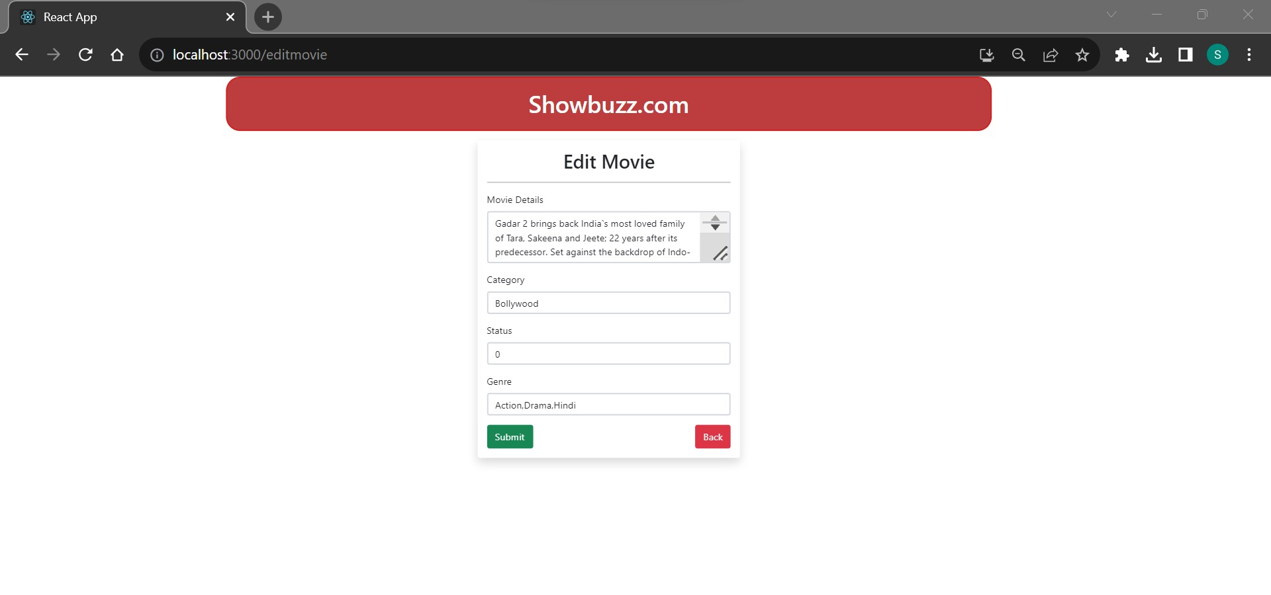

Slide 17
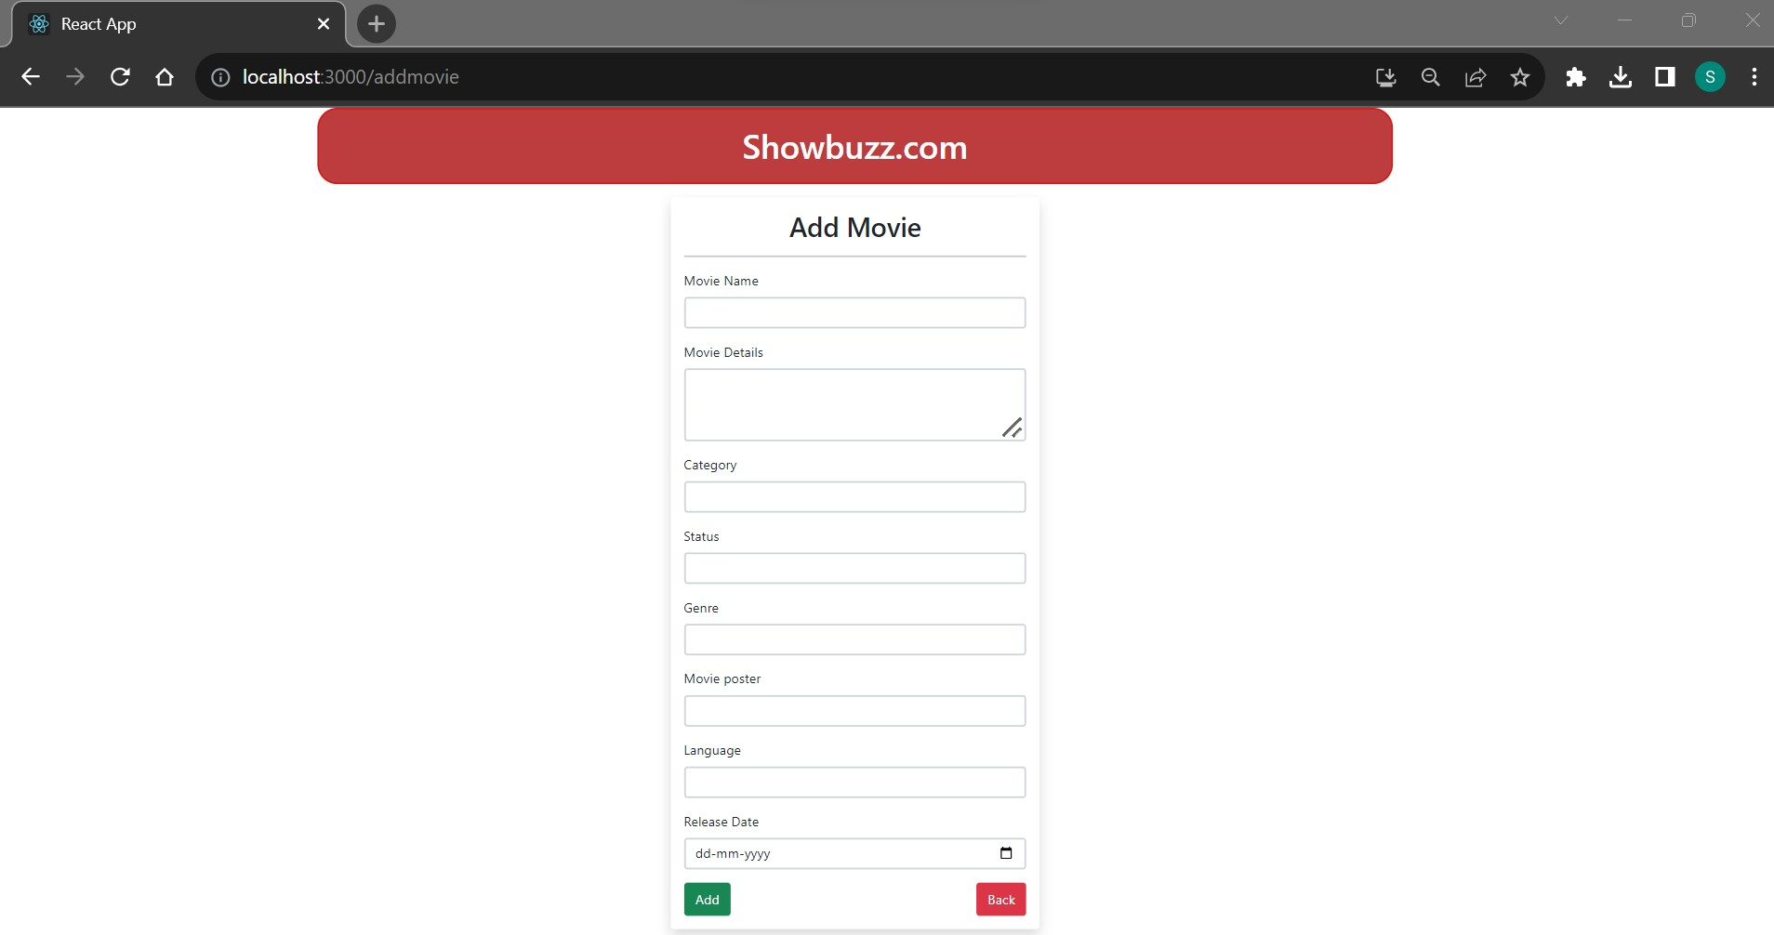

Slide 18
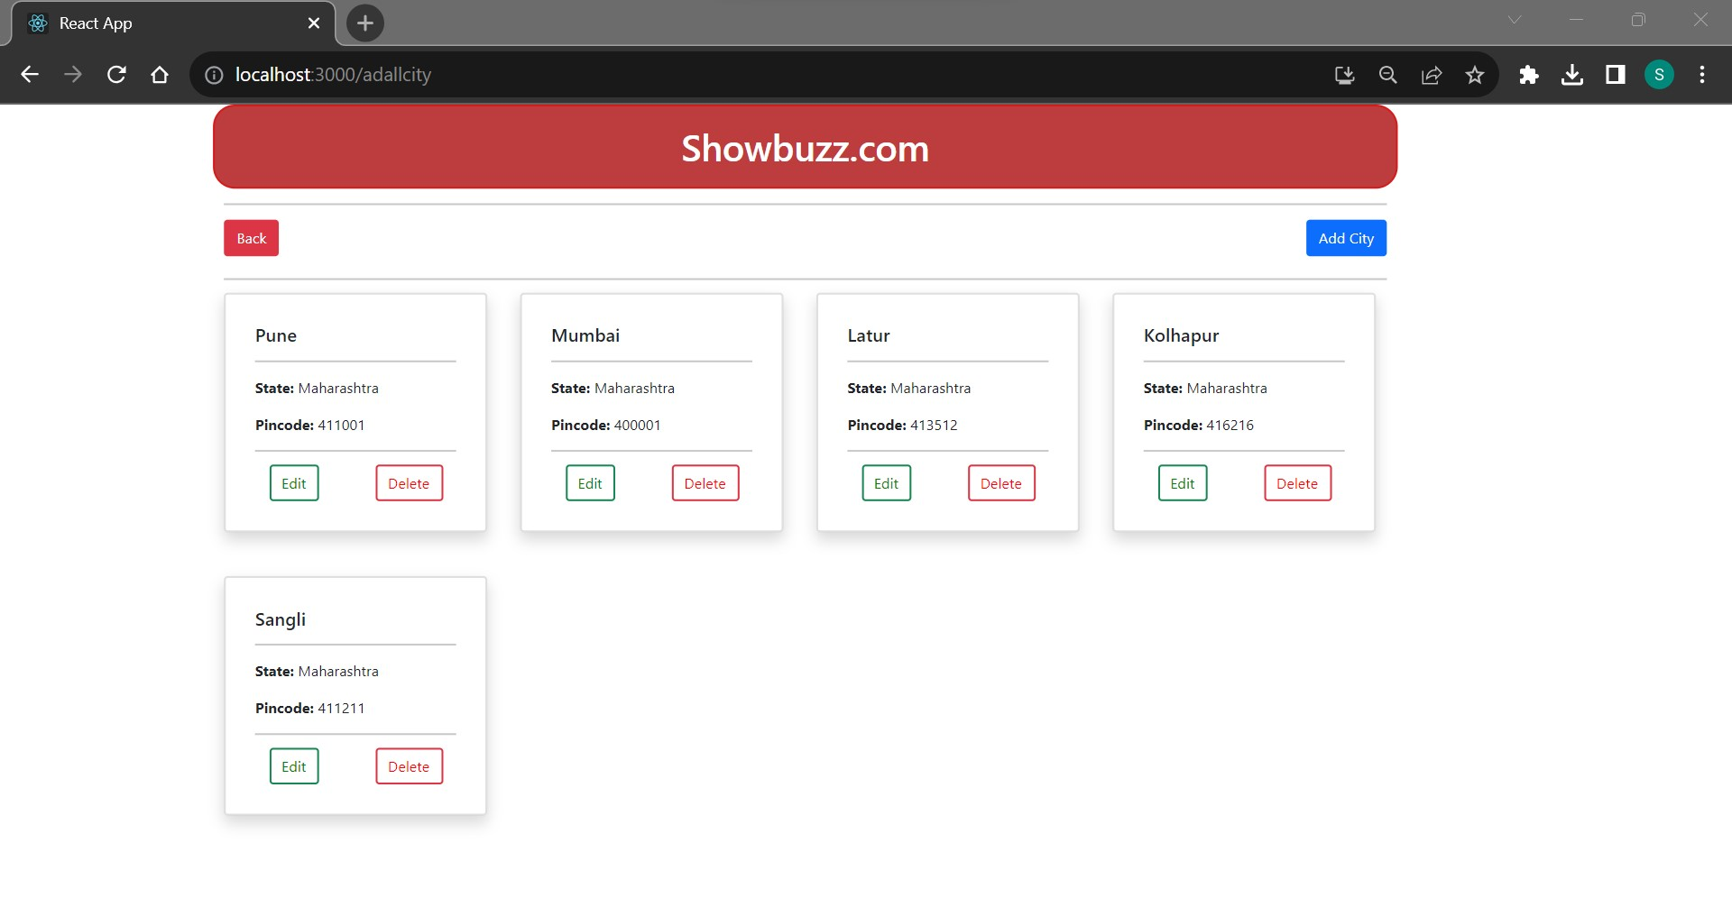

Slide 19
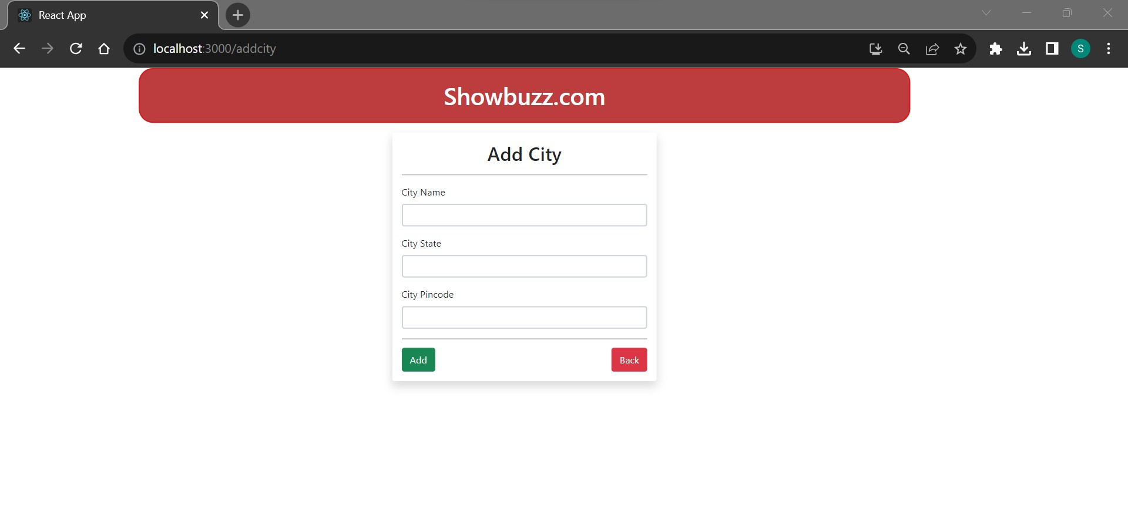

Slide 20
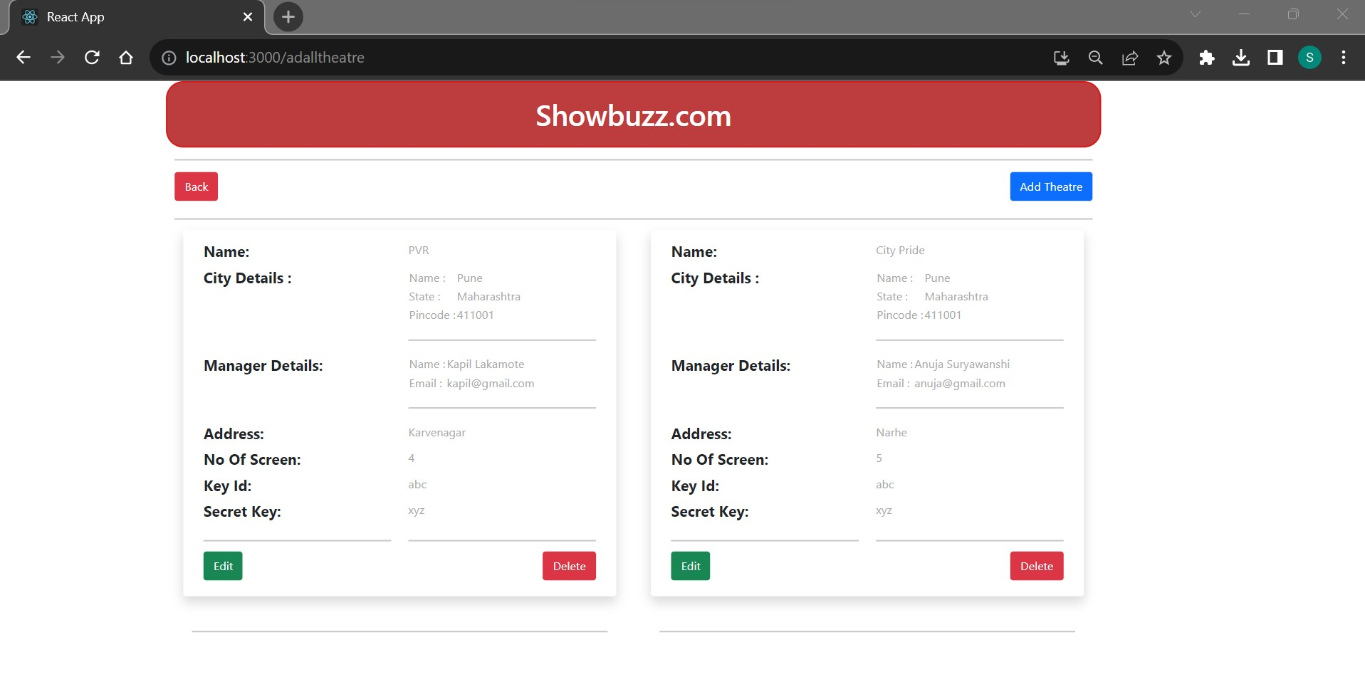

Slide 21
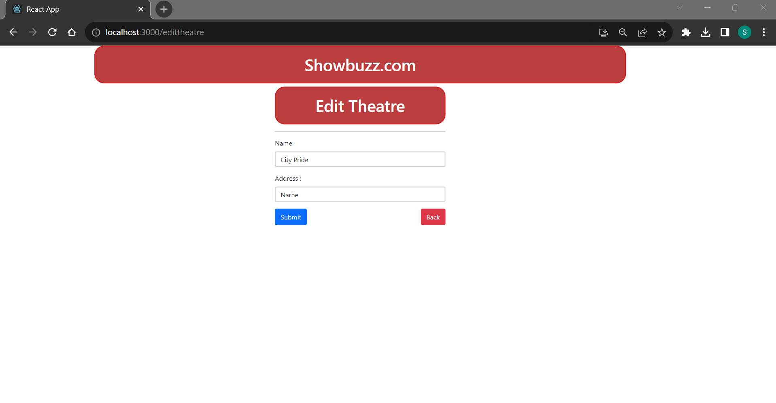

Slide 22
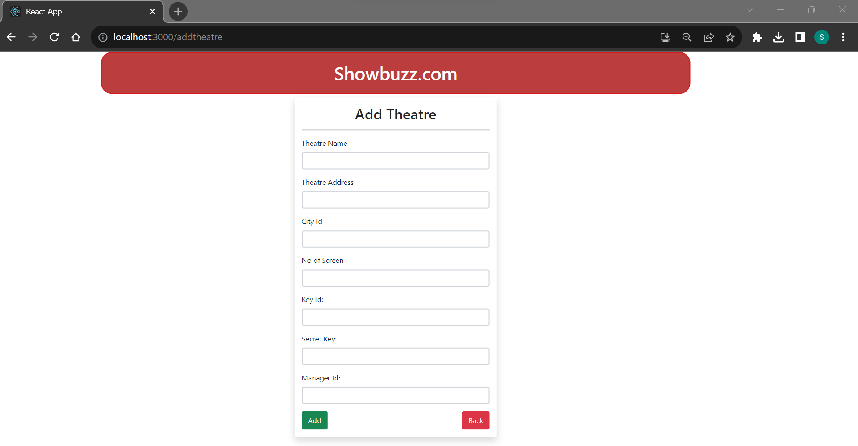

Slide 23
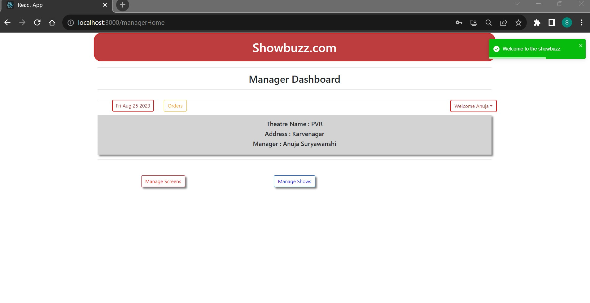

Slide 24
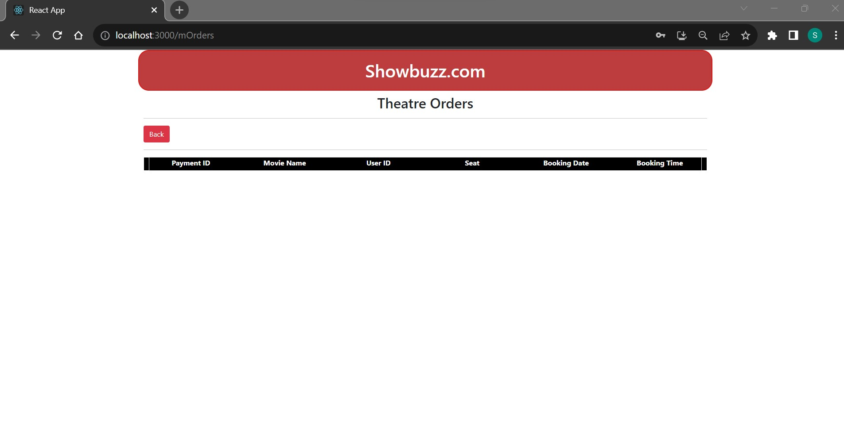

Slide 25
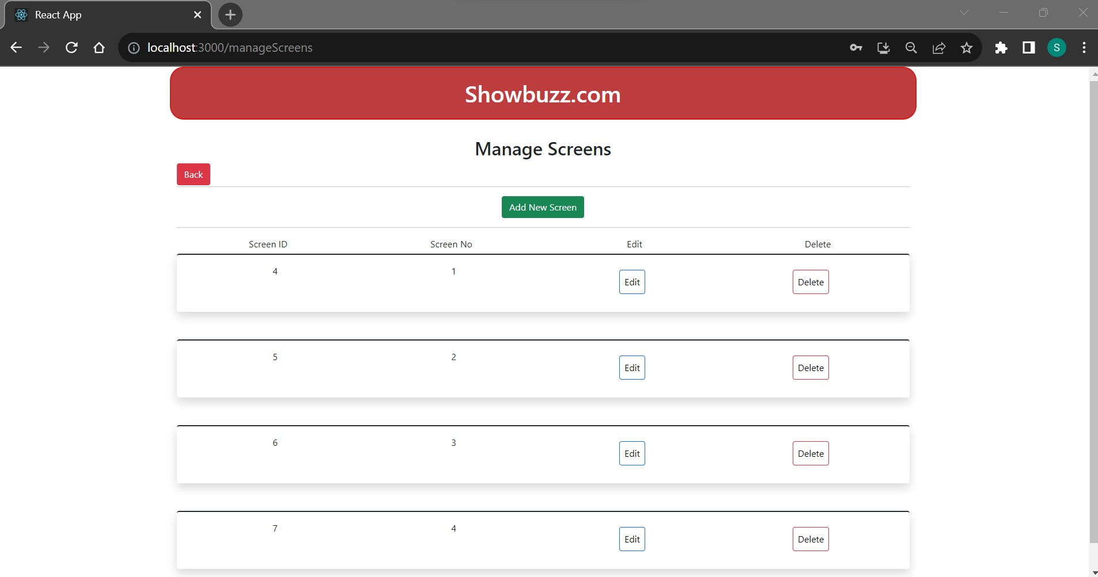

Slide 26
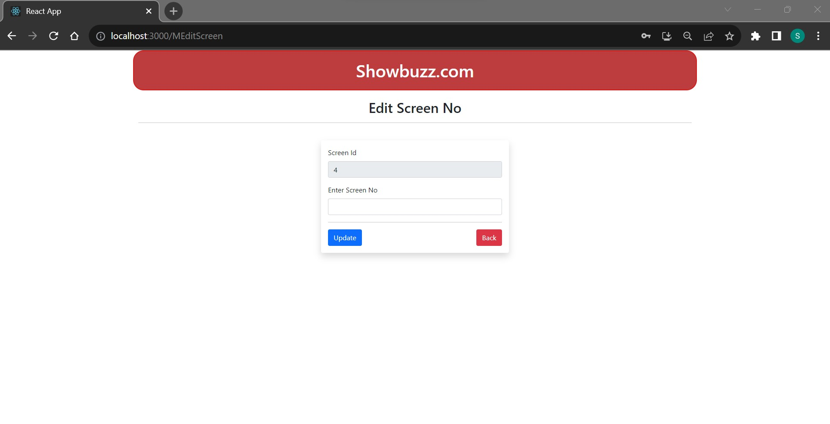

Slide 27
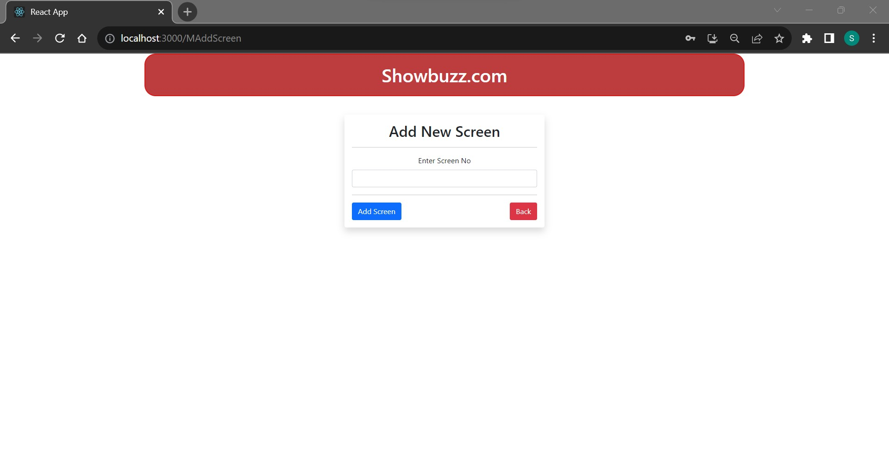

Slide 28
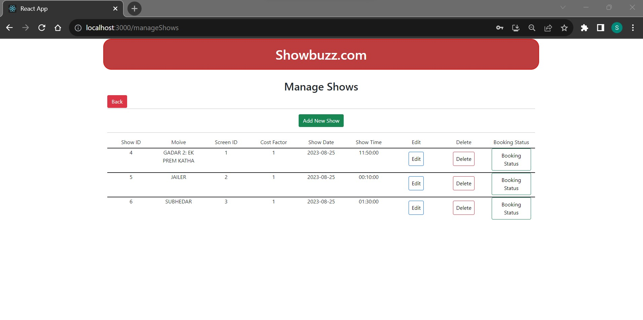

Slide 29
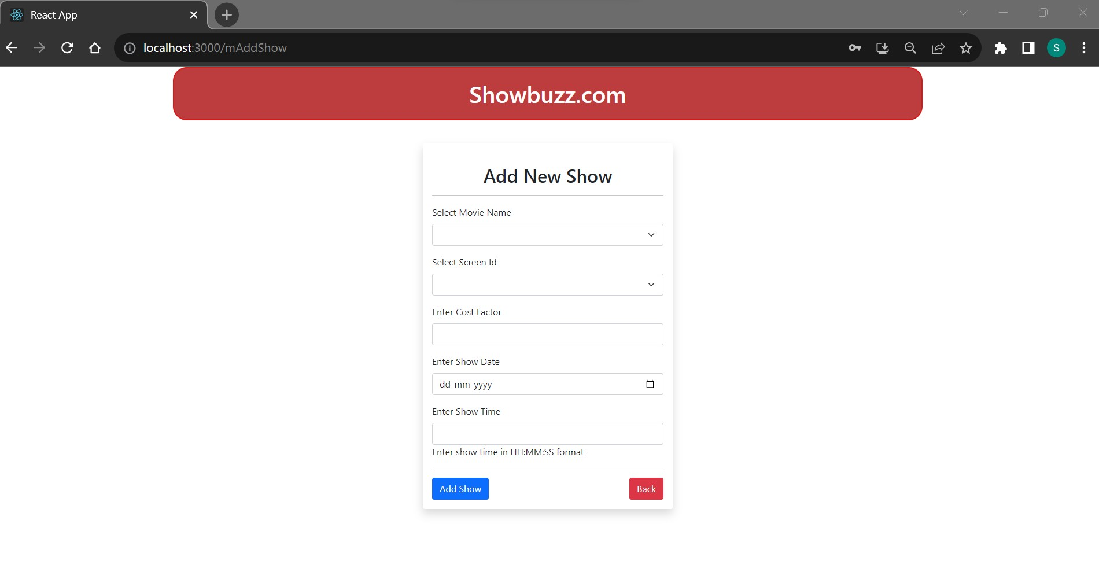

Slide 30
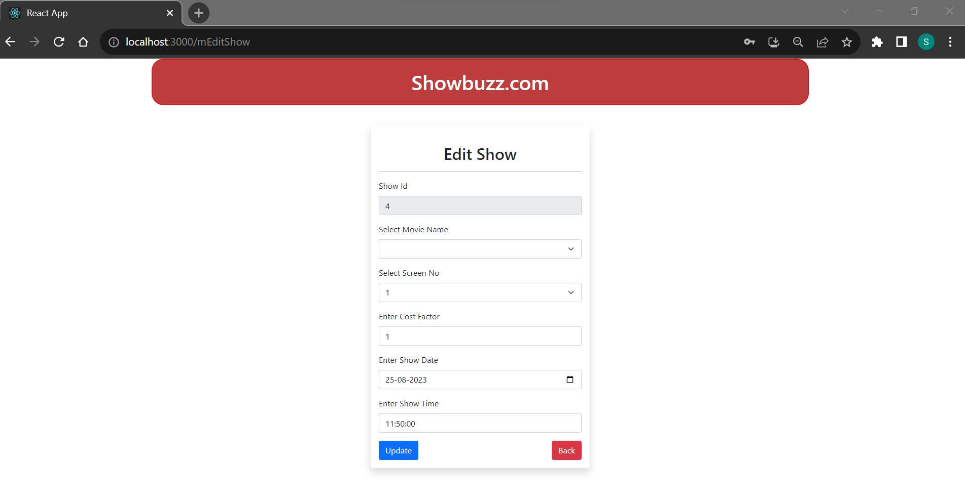

Slide 31
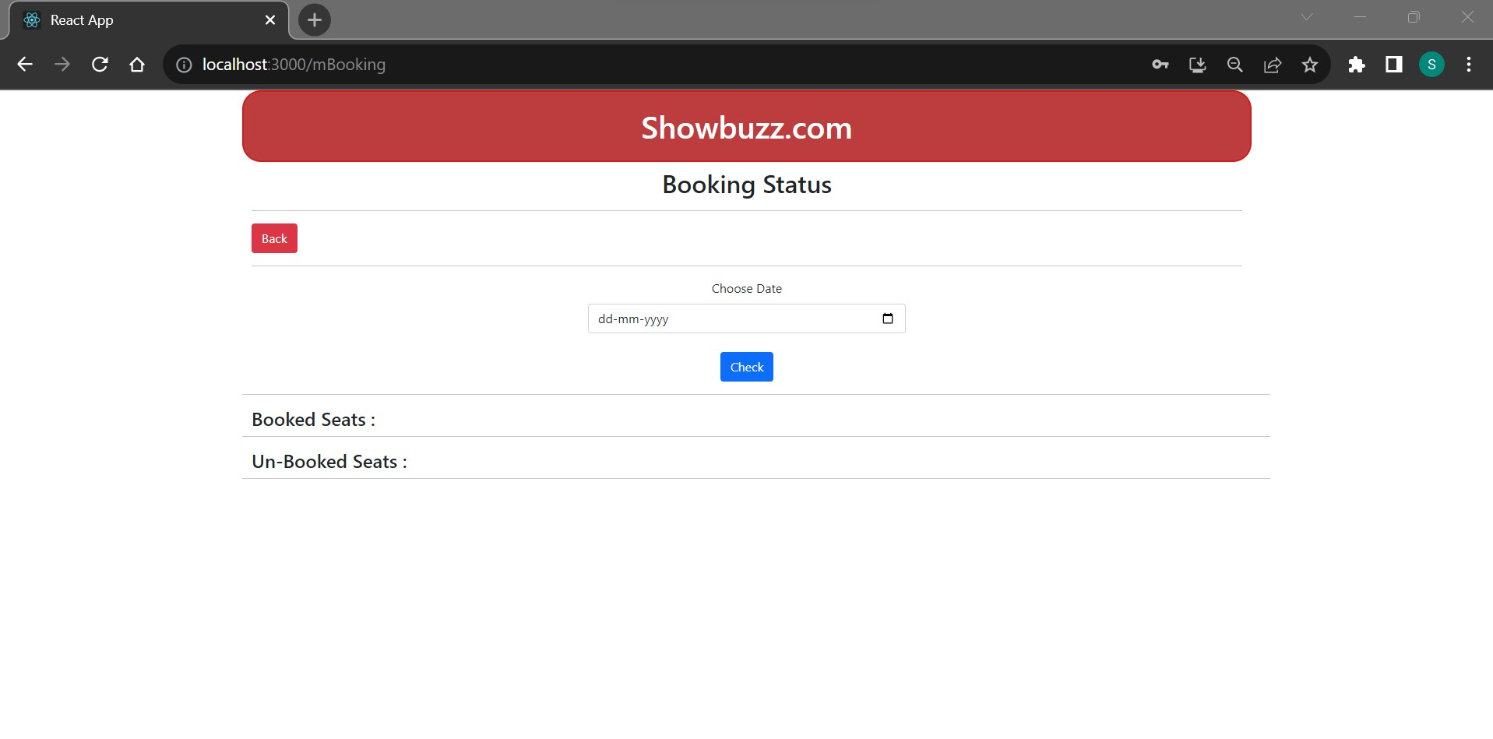

Slide 32
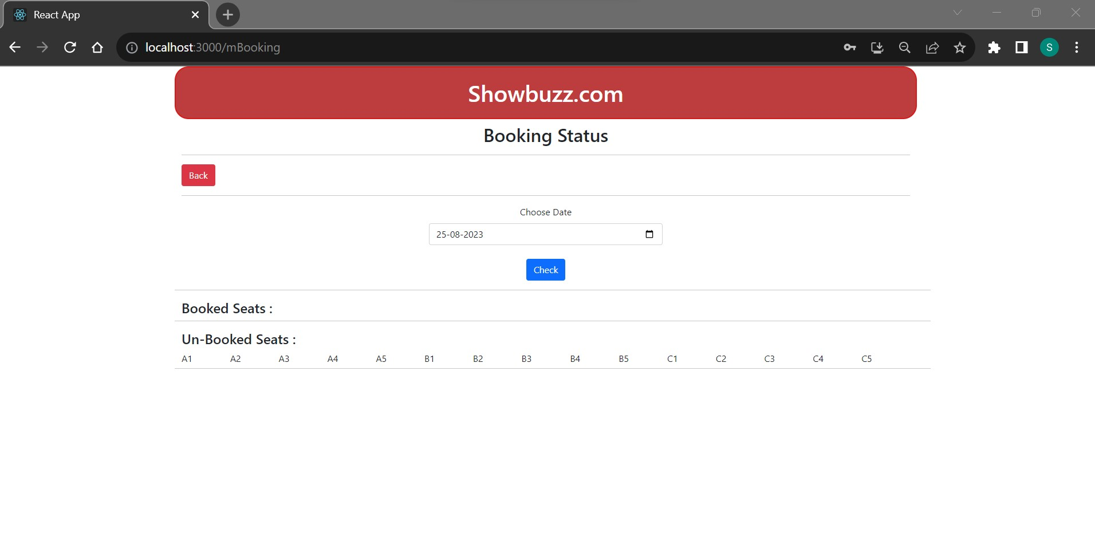

Slide 33
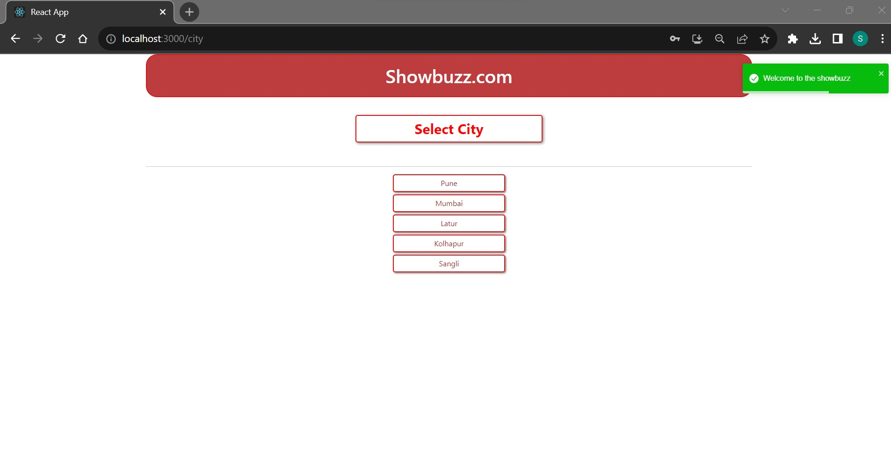

Slide 34
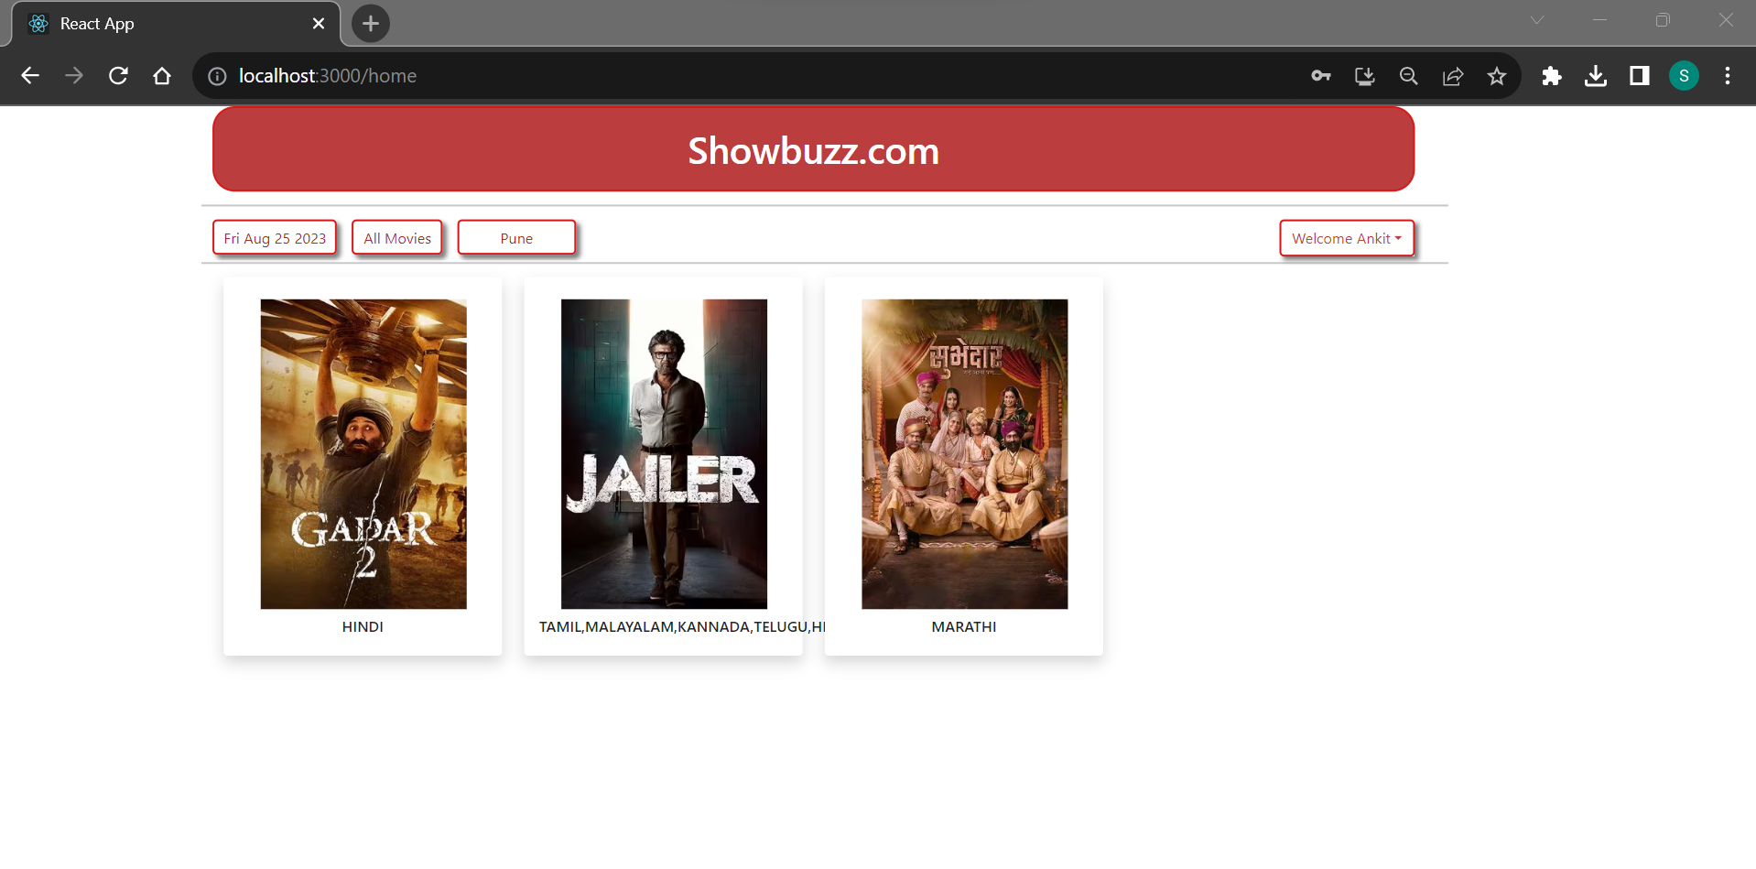

Slide 35
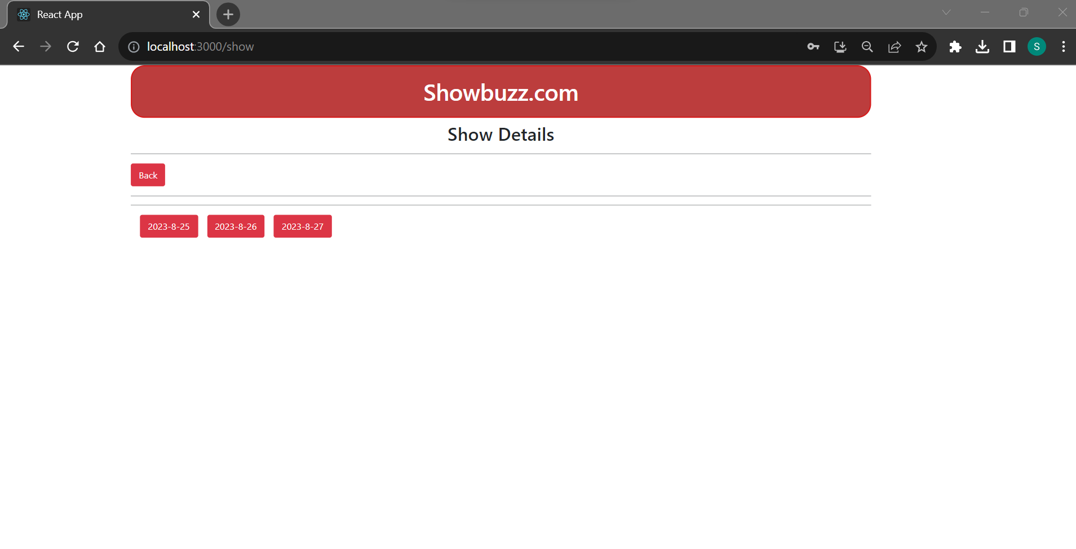

Slide 36
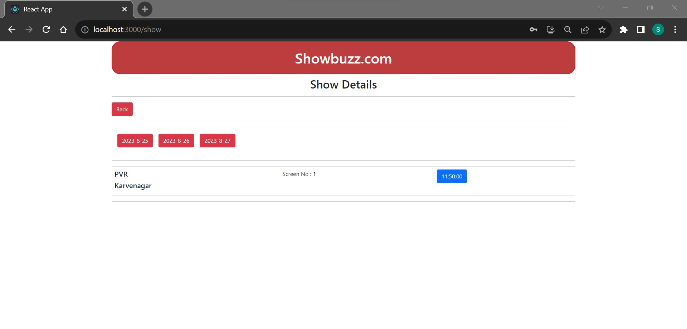

Slide 37
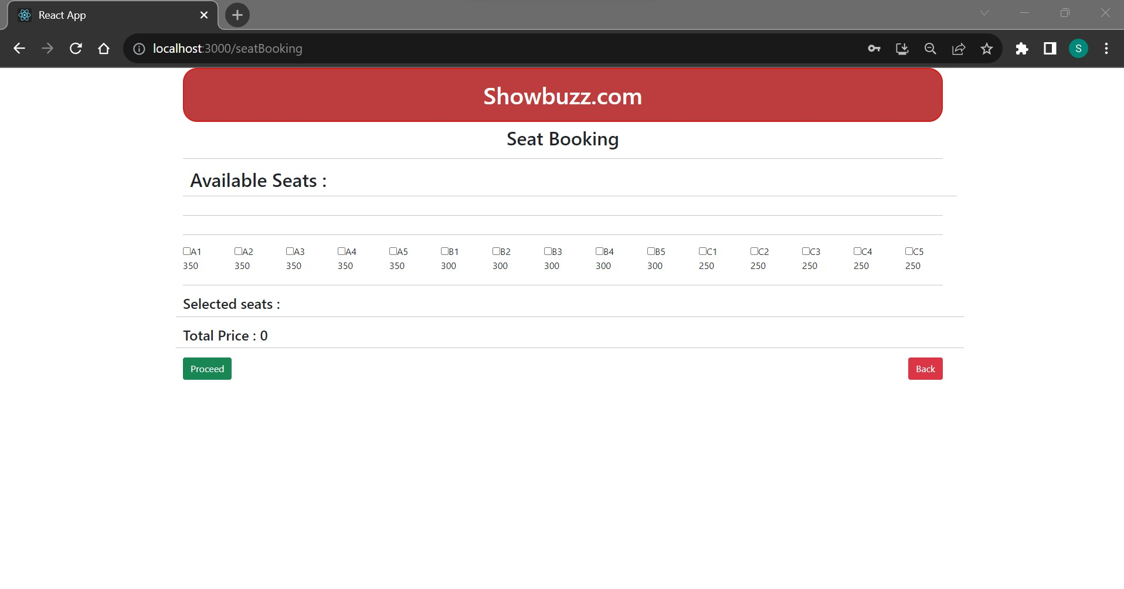

Slide 38
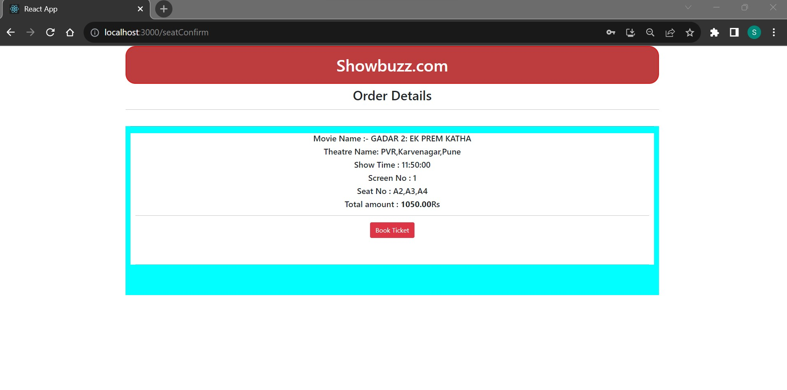

Slide 39
